Slide 1
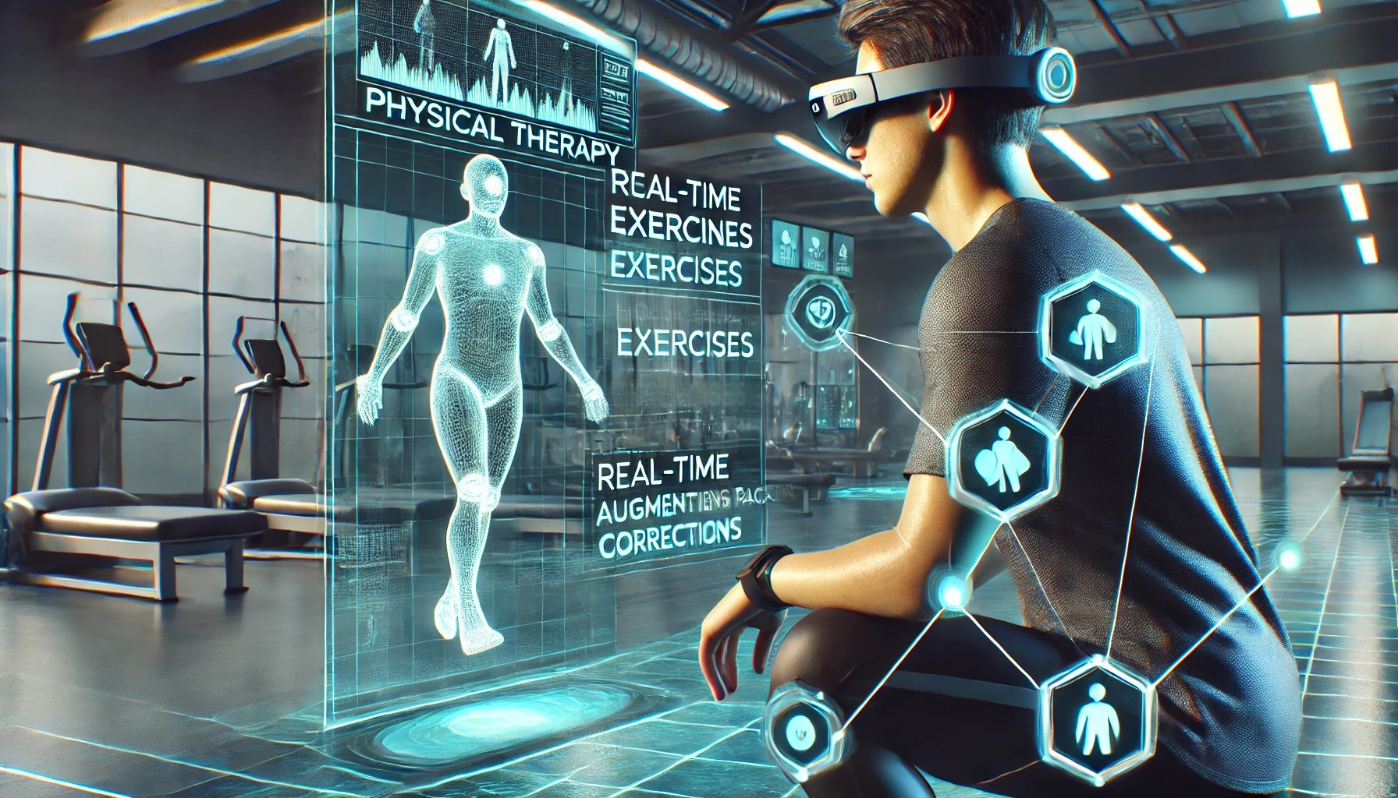
The Future of Physical Therapy
2/13/2025
ThAIrpy

Slide 2


Meet the Team
Malek Kchaou
Jack
Gerety
Computer Science | Mathematics
Computer Science | Mathematics

Slide 3
What is ThAIrpy?
Problem Statement
For Patients:
🏆 Better Therapy Outcomes – Patients often struggle when they live the clinic and improper form could lead to slow recovery, reinjury or long-term complications.
💰 Cost – Expensive therapy sessions and insurance limitations.
🚧 Access – Limited availability of therapists, long wait times, and location constraints.
🎯 Engagement – Difficulty staying motivated and following prescribed exercises.
📊 Progress Measurement – Lack of real-time feedback and objective progress tracking.
For Therapists:
📊 Tracking of Patient Progress – Limited ways, real-time data and insights to monitor patient adherence and recovery at home.
📡 Keeping Up with Emerging Tech – Rapid advancements in AI and AR require constant learning.
📑 Documentation Overload – Excessive paperwork reduces time spent with patients.
🔄 Retention – High dropout rates due to patient disengagement.

Slide 4
What is ThAIrpy?
Proposed Solution:
Core features:
An AI-enhanced Augmented Reality (AR) system that guides patients through physical therapy exercises.
Instant feedback on form and technique, ensuring exercises are performed correctly.
Personalized adjustments based on real-time performance, enhancing recovery efficiency.
Augmented reality visuals overlaying accurate exercise instructions, demonstrating proper movements and posture.
Offering better ways to manage documentation on both patient and therapist’s sides.
Benefits for Stakeholders:
For Patients: A more engaging, personalized, and accurate therapy experience.
For Physical Therapists: Improved monitoring and a more efficient way to track patient progress.
For Healthcare Systems: Better outcomes through AI-driven insights, reducing the risk of human error and speeding up recovery.

Slide 5
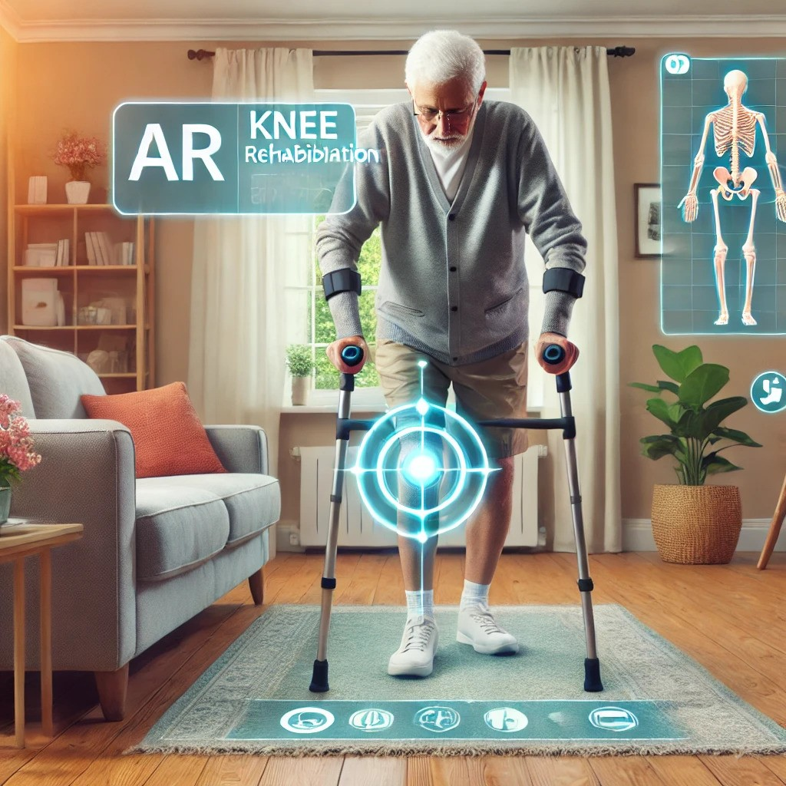
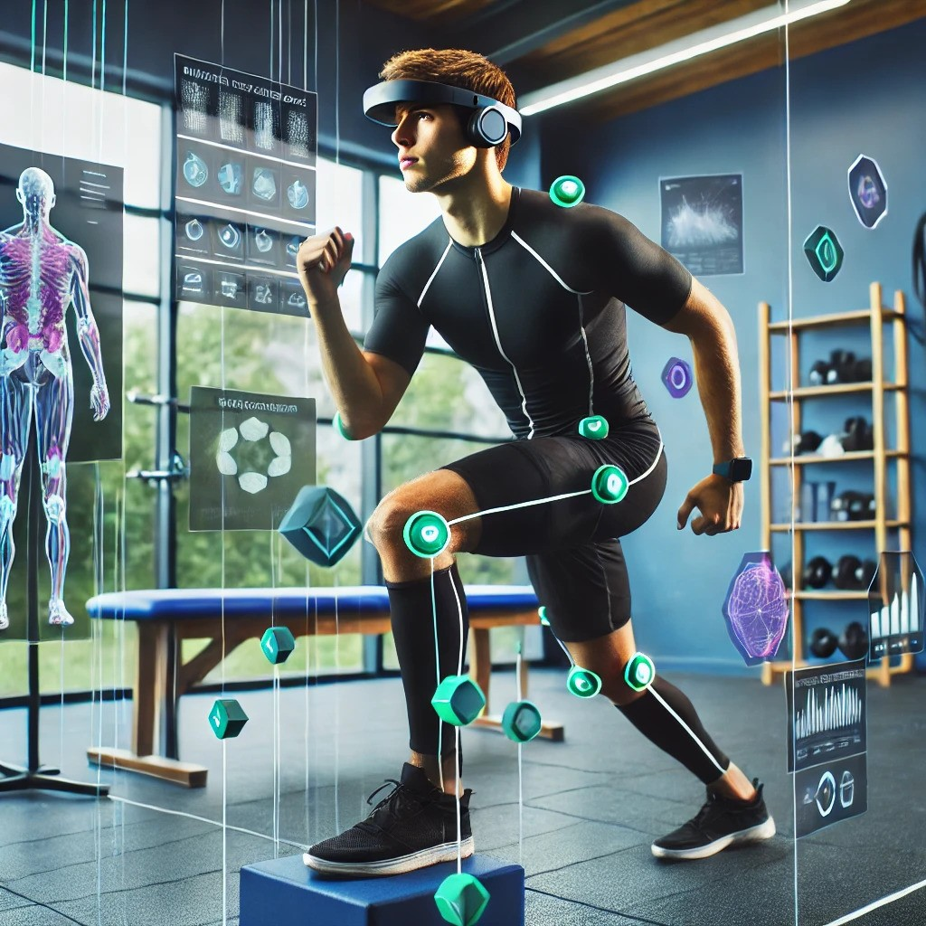
Target Customers
Patients recovering from surgery or injuries.
Physical therapy clinics and therapists.
Elderly individuals or those with chronic conditions.
People with no access to traditional therapy options.

Slide 6
Project Timeline
Present — MAY 25
MAY 25 — SEPT 25
SEPT 25— JAN 26
JAN 26 — AUG 26
MVP Development (AI features)
User Experience (UX) and Interface Design
Integration of Monitoring and Progress Tracking
Scaling and Expansion (AR)
Duration: 2-3 months
During this phase, we’ll ensure the development of a functional AI prototype with the core features (exercise tracking, real-time feedback, corrections).
Duration: 3-4 months
This phase can overlap with some of the final stages of Phase 1.
User testing will be crucial here to ensure the interface is simple, intuitive, and effective.
Duration: 3-4 months
This phase adds features that allow for continuous monitoring of patient progress over time and ensure the latter work well with our AI system.
Duration: 6-8 months
The system will be scaled to incorporate augmented reality (AR) or virtual reality (VR) features for enhanced interaction and more immersive therapy.

Slide 7
Join us in shaping the future of rehabilitation.

